Slide 1

Student Details
Name : VEMULA PUJA
E-MAIL ID : vemulapooja857@gmail.com
Student.id : 22hp1a0583
Department&year : cse-3rd year

Slide 2
PROJECT TITLE/Problem Statement
HIDING A TEXT INSIDE THE IMAGE USING STEGANOGRAPHY

Slide 3
AGENDA

Slide 4
PROJECT OVERVIEW
Our steganography tool provides a robust, versatile, and user-friendly solution for hiding and protecting sensitive data within digital media. By offering advanced features and strong security measures, we ensure that our users can confidently secure their information and maintain their privacy in an increasingly digital world.

Slide 5
WHO ARE THE END USERS of this project?
Cybersecurity Professionals
Use steganography to protect sensitive information and enhance data security.
Develop and implement steganalysis techniques to detect hidden data in digital communications.
Journalists and Whistleblowers
Use steganography to safely share sensitive information without revealing their sources or risking exposure.
Law Enforcement and Intelligence Agencies
Detect and analyze hidden communications used by criminals and terrorists.
Software Developers and Researchers
Develop new steganography algorithms and tools.

Slide 6
YOUR SOLUTION AND ITS VALUE PROPOSITION
.
Our solution provides a comprehensive steganography tool that allows users to embed hidden messages within various types of digital media such as images, audio files, and videos. The tool leverages advanced algorithms to ensure that the hidden data is imperceptible to human senses and resistant to detection by steganalysis techniques.
Value Proposition:
Enhanced Security : Our solution enhances the security of sensitive information by providing a layer of protection.
Versatile Applications : Suitable for wide range of users.
Cost-Effective : Provides a cost effective solution for securing data without expensive hard or software.
Continuous Improvement : Regular updates and improvement.
Ease of use : Designed with user experience in mind.

Slide 7
How did you customize the project and make it your own

Slide 8
MODELLING
.
Image Processing Module:
Load image from specified path.
Check if image is successfully loaded.
Get image dimensions (height, width, channels).
Save modified image to a new file.
Open the newly saved encrypted image.
Steganography Algorithm Module:
Loop through the secret message and encode each character into the image.
Use the hashed password to modify pixel values securely.
Cryptographic Module:
Prompt user for secret message and password.
Use the hashed password to ensure secure encoding.

Slide 9
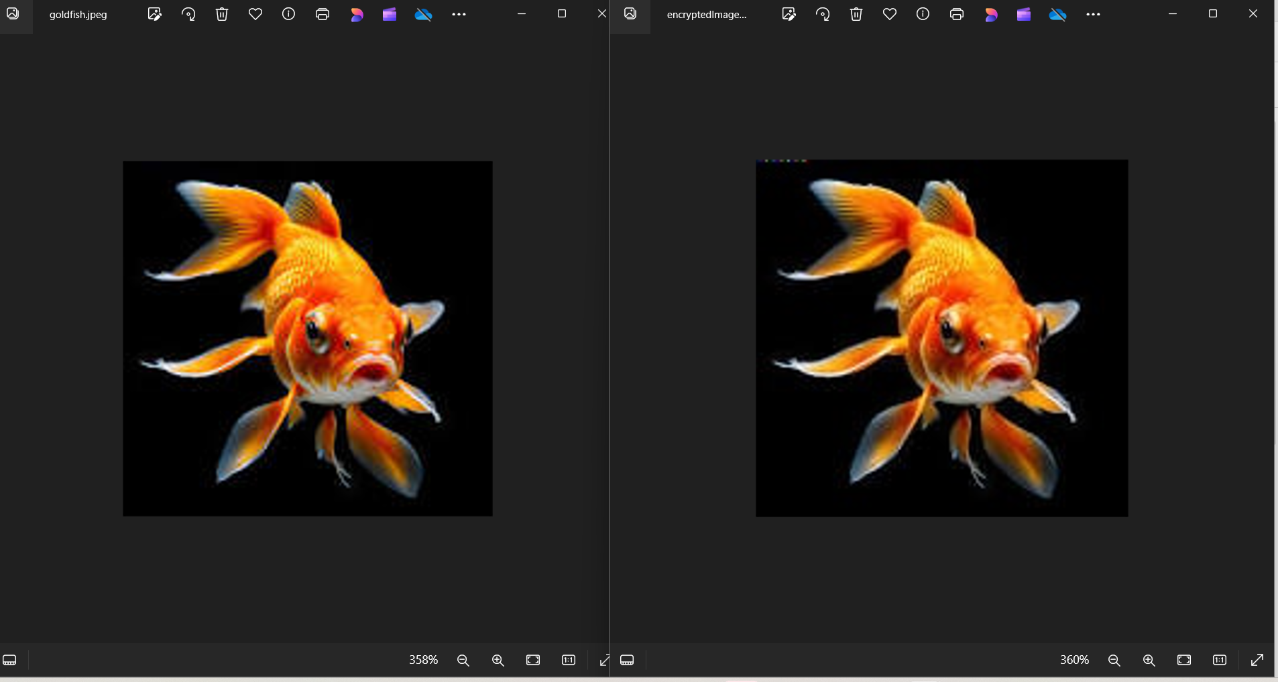
Results

Slide 10
links

